Slide 1
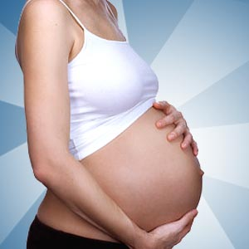
Subclinical hypothyroidism in pregnancy
Dr Nicola Zammitt
Consultant Physician
Royal Infirmary of Edinburgh
PLIG meeting 23/1/20

Slide 2
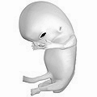
Hypothyroidism during pregnancy
Fetus needs T4 from 4-5/40
Uses maternal T4 exclusively up to 10/40 and partially thereafter.
T4 requirements can increase by 50% by 20/40 then plateau
Increase T4 dose by 25mcg when pregnancy confirmed
TFTs each trimester
Check TFTs pre-pregnancy in:
  autoimmune disease (eg T1DM)
  current or PHx/FHx thyroid disease
  features of thyroid disease eg Goitre

Slide 3
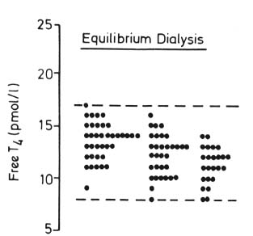
Reference ranges in pregnancy (Refhelp)
Free T3 and Free T4
Change during Pregnancy
1 2 3
 | 1st trimester | 2nd trimester | 3rd trimester
FT4 pmol/l | 10-18 | 9-16 | 8-14
FT3 pmol/l | 3.2-5.6 | 3.1-5.2 | 3.0-5.1
TSH mU/l | 0.09-2.8 | 2.0-2.8 | 0.3-2.9
Only check free hormones: TBG ↑ in pregnancy (oestrogen effect)

Slide 4
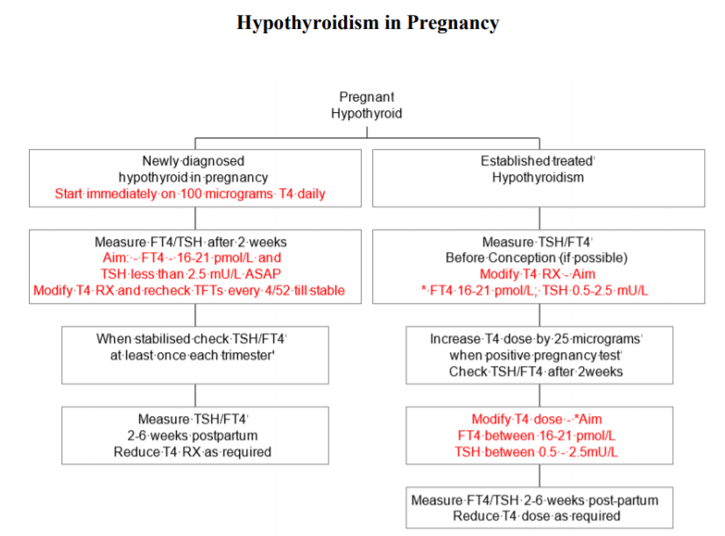

Slide 5
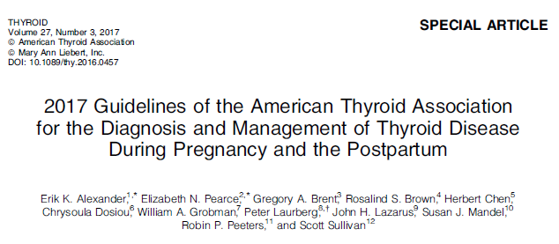
Subclinical hypothyroidism – slightly more tricky
Updated Refhelp guideline based on ATA guidelines plus TABLET trial

Slide 6
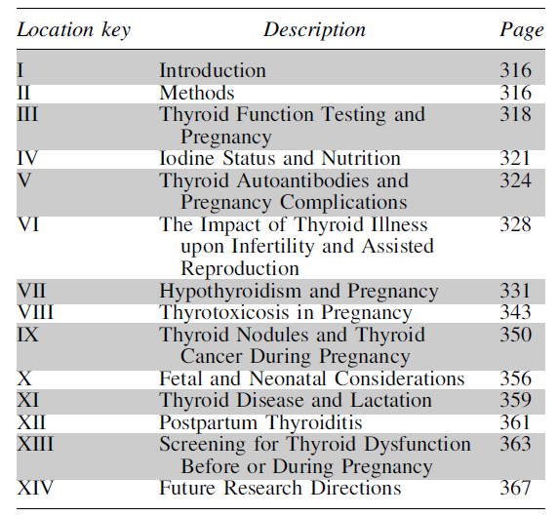
ATA Pregnancy guidelines
Overview

Slide 7
Hypothyroidism and pregnancy
2-3% of healthy non-pregnant women of childbearing age have an elevated TSH
Prevalence may be higher in areas of iodine insufficiency
In areas of iodine sufficiency, the most frequent cause of hypothyroidism is autoimmune
TPOs detectable in up to 60% women with raised TSH
BMI, geography and ethnicity affect normal TSH range
Important to have local trimester-specific ranges,
In pregnancy: any elevation of TSH above range represents maternal hypothyroidism

Slide 8
Hypothyroidism and pregnancy

Slide 9
Hypothyroidism and pregnancy
Adverse outcomes associated with overt hypothyroidism
Pregnancy complications
  Premature birth
  LBW
  60% risk of fetal loss if not adequately treated
  22% risk gestational hypertension
  Increased risk of fetal death
Fetal neurocognitive development
  Lower offspring IQ

Slide 10
SCH and pregnancy
Adverse outcomes assoc. with subclinical hypothyroidism
Subclinical hypothyroidism is variably associated with an
increased risk of adverse pregnancy outcomes in most studies
Differing TSH cut-offs in different studies
Many studies did not account for TPO status
Studies examining association between elevated maternal TSH and adverse endpoints can be grouped into 3 categories
  Adverse effects on pregnancy loss
  Adverse pregnancy outcomes
  Adverse neurocognitive outcomes (IQ) in offspring.

Slide 11
SCH and pregnancy
Pregnancy loss
Early fetal loss difficult to study
  30% background miscarriage rate
  Most loss occurs before pregnancy clinical recognised
Studies suggest link between high TSH and pregnancy loss
  Negro et al: higher pregnancy loss rate in TPO neg women with TSH 2.5-5 vs women with TSH <2.5 (6.1 vs 3.6%)
  Australian cohort: early-pregnancy TSH levels >95th percentile were associated with increased risk of miscarriage (OR 3.66) although subclinical and overt hypothyroid cases were pooled

Slide 12
SCH and pregnancy
Pregnancy loss
Studies suggest link between high TSH and pregnancy loss
  A separate retrospective study of 202 early pregnancies that subsequently miscarried showed higher mean TSH and lower FT4 concentrations as well as a higher prevalence of TSH concentrations >97.5th percentile and FT4 concentrations <2.5th percentile compared to 3592 normal pregnancies.
  Liu et al demonstrated a graded increase in miscarriage risk as maternal TSH concentrations increased. Effect augmented by TPO positivity

Slide 13
SCH and pregnancy
Pregnancy loss
Studies suggest link between high TSH and pregnancy loss
  Negro et al: SCH increases risk of pregnancy complications in TPO +ve women
  Prospective study >4600 subjects. Women randomised to universal screening vs case finding in pregnancy
  TPO +ve women with TSH >2.5 treated with LT4
  LT4 treatment (vs no treatment) led to reduction in composite end point of pregnancy complications
  Composite endpoint is a significant limitation as many variables were subjective.
  No benefit to universal screening vs case finding of high risk women

Slide 14
SCH and pregnancy
Pregnancy complications: Preterm delivery
Casey et al, 2007 (largest study) :
  17,298 pregnant women. SCH associated with increased risk preterm delivery <34/40 (4% vs 2.5%; p=0.01)
  No increased risk for preterm delivery <32/40 or <36/40
  Lack of continuous effect raises Qs about 34/40 data
Cleary-Goldman et al, 2008: no association between raised TSH and delivery <37/40. Conflicting results in other studies
  Some studies pooled overt and SCH, different TSH cut-offs, confounders (eg TPO positivity or comorbidities)
  Recent study compared fixed cut-off of TSH 2.5 vs TSH >97.5th percentile (4mU/l). Increased risk prem delivery in TSH >4, but assocn. lost if comorbid/TPO+ excluded.

Slide 15
SCH and pregnancy
Pregnancy complications: BP, BW, mortality
Most studies of BP did not find association with high TSH
Mannisto et al: TFTs at 12/40 in 5805 women. No link between TFTs and perinatal mortality
Several studies: no link between SCH and very low /high BW
Recent meta-analysis analysed pregnancy outcomes in relation to maternal thyroid status.
  Increased risk of pregnancy loss, preterm delivery and placental abruption in SCH in early pregnancy
Overall: increasing risk of pregnancy complications (mainly preterm delivery and pregnancy loss) with elevated TSH.
TPOs: risk in TPO +ve women with TSH >2.5mU/l but risk not apparent in TPO negative women till TSH>5-10mU/l

Slide 16
SCH and pregnancy
Neurocognitive effects on child
Haddow 1999: large case-control study. Children of women with overt, untreated hypothyroidism: 7 point IQ reduction, delayed motor skills, language and attention at 7-9 y/o
3 small studies of TPO status suggest effect on neuro-cognitive outcomes. Need to confirm in larger studies.
Controlled Antenatal Thyroid Screening (CATS; CATS2) study
  Large prospective RCT assessing benefit of popn screen
  Raised TSH or low T4 triggered LT4 Rx at mean 13+3/40. No improvement in cognitive function at 3 y/o.
Prelim results of another large RCT for LT4 vs placebo in SCH also showed no benefit (but not treated till mean 17/40)
Insufficient evidence that treating SCH helps cognition
Notes:
Preliminary results of another large multicenter, randomized, controlled trial, the Randomized Trial of Thyroxine Therapy for Subclinical Hypothyroidism or Hypothyroxinemia Diagnosed During Pregnancy, have recently become available. This study screened 97,226 pregnant women in order to randomize 677 women with
subclinical hypothyroidism and 526 women with isolated maternal hypothyroxinemia to LT4 treatment versus placebo at a mean time point of 17 weeks. Similarly, this study
demonstrated no significant effect of treatment on offspring
IQ at the age of 5 years (21).

Slide 17
SCH and pregnancy
Neurocognitive effects on child
However, lack of positive data does not rule out effectiveness of intervention
  Studies difficult to enrol to
  Heterogeneous parameters: timing of LT4 intervention, TSH cut-offs, duration and severity of maternal hypthyroidism (not controlled for – most studies just use one baseline TSH measurement)
Reiterate dangers of OVERT hypothyroidism
What is uncertain is the nuanced understanding of risk of SCH and how to minimise it.
Cause of hypothyroidism also changed from mainly iodine deficiency to autoimmune disease

Slide 18
SCH and pregnancy
Recommendations
L-T4 recommended for:
  TPO +ve women with TSH above pregnancy ref range
  TPO –ve women with TSH >10
L-T4 NOT recommended for:
  TPO –ve women with normal TSH (eg 2.5-4.5)
L-T4 may be considered for:
  TPO positive women with TSH 2.5-top of reference range (more recent evidence suggests no benefit in this group)
  TPO negative women with TSH 4.5-10 (I would treat this group)

Slide 19
Possible sub-clinical hypothyroidism, in women of reproductive age
TSH 4.5 – 10 mU/L
FT4 in ref range*
Consider underlying cause:
recovery from illness
medication
sub-clinical hypothyroidism
(no previous abnormal TFTs)
ask about pregnancy
Offer pre-conception counselling for possible sub-clinical hypothyroidism
not planning pregnancy
trying for a pregnancy
pregnant
Request anti-TPO (if none previous)
T4 therapy likely required
Refer to local guideline
Repeat TFTs at 3 months
Request anti-TPO (if none previous)
anti-TPO neg
anti-TPO positive
Repeat TFTs at 3 months
Start T4 therapy eg 25-50 mcg levothyroxine
Review after 6 weeks
TSH in ref range
or
TSH <10 mU/L,
and anti-TPO neg
TSH >10 mU/L
Start T4 therapy
- Unlikely sub-clinical
hypothyroidism
- No further action
TSH in ref range
TSH >10 mU/L
TSH 4.5 – 10 mU/L
anti-TPO positive
- Unlikely sub-clinical
hypothyroidism
- No further action
Start T4 therapy
- Annual TFTs
- Repeat pre-conception advice for sub-clinical hypothyroidism
TSH 4.5 – 10 mU/L
Seek advice from endocrinology re: ongoing management
*Laboratory will selectively add:
- comment pointing to this guidance
anti-TPO request

Slide 20
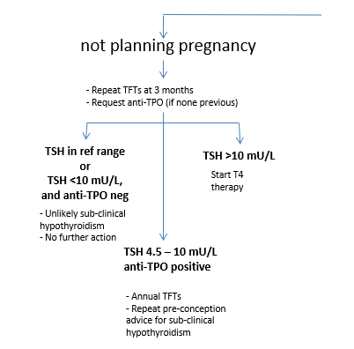
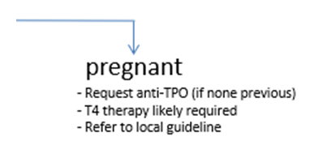

Slide 21
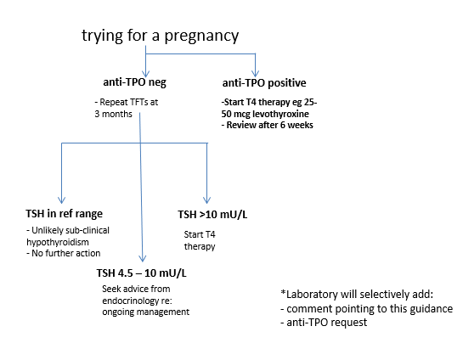

Slide 22
TABLET trial
TPO +ve EUTHYROID women
TPO Abs associated with increased risk of miscarriage and preterm birth, even if TFTs are normal
Small trials suggest L-T4 can reduce these adverse outcomes
Double blind RCT of euthyroid TPO +ve women with Hx miscarriage or infertility
476 placebo vs 476 50mcg L-T4 pre-conception to birth
Primary outcome was live birth >34/40

Slide 23
Pregnancy rates 56.6% vs 58.3% in L-T4 and placebo groups
No significant between-group differences in other pregnancy outcomes, including pregnancy loss, preterm birth or neonatal outcomes
No significant difference in adverse events between the two groups
Use of L-T4 in TPO +ve euthyroid women does not result in higher birth rates

Slide 25
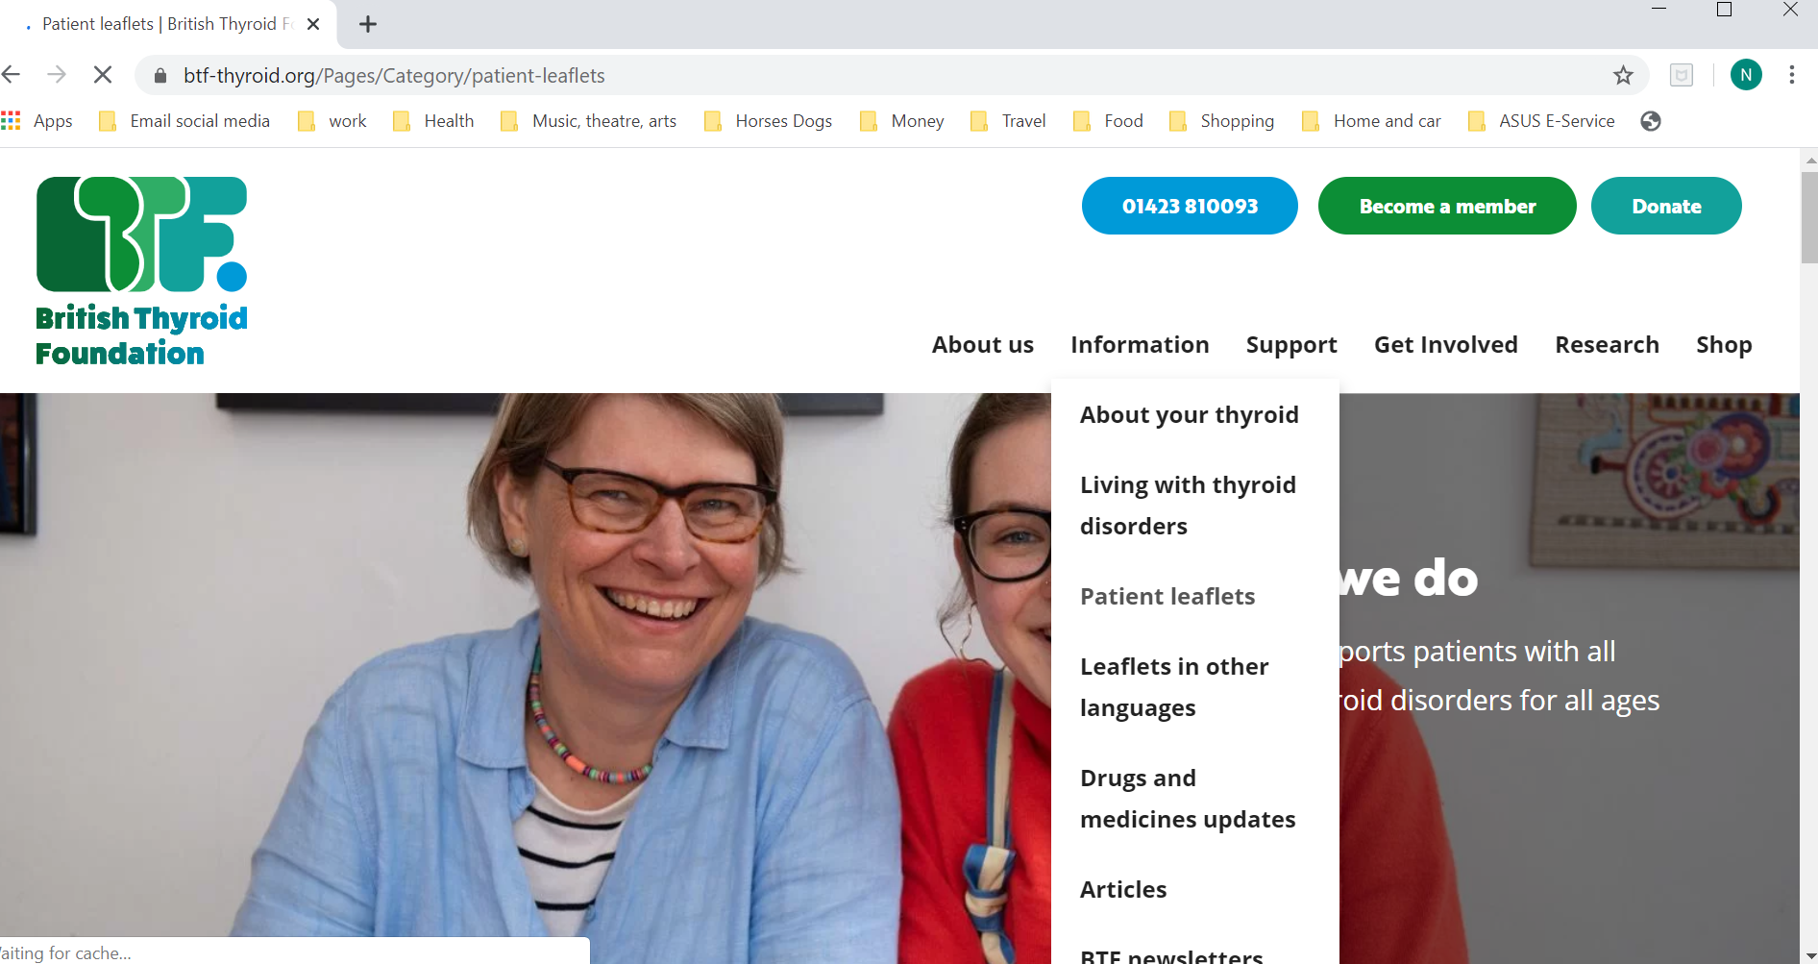
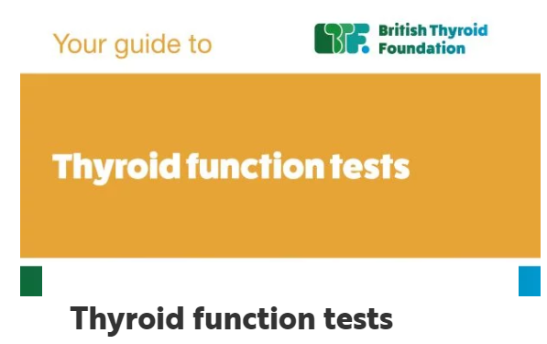
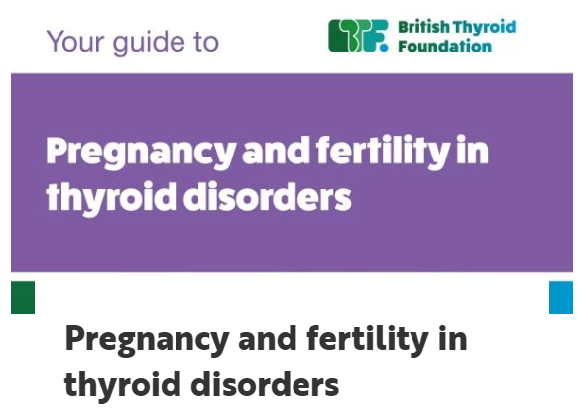
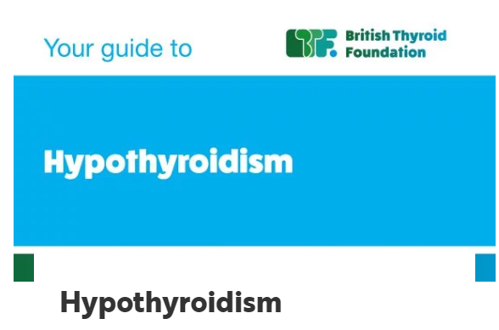
Resources: www.btf-thyroid.org

Slide 26
Sub-clinical hypothyroidism: conclusions
Treat any elevation of TSH above pregnancy reference range
L-T4 recommended for:
  TPO +ve women with TSH above pregnancy ref range
  TPO –ve women with TSH >10 (and probably >4.5)
L-T4 NOT recommended for:
  Euthyroid women regardless of TPO status
Useful patient material on www.btf-thyroid.org
Full updated guidance now on Refhelp
(For hypothyroid women, increase LT4 25mcg on +ve pregnancy test.)
Use only FREE T4 and FT3 in pregnancy

Slide 27
Thank you
Any questions or comments?

Slide 28
SCH and pregnancy
Adverse outcomes assoc. with subclinical hypothyroidism
Table 5: overview of all observational and prospective studies (> 400 subjects) on effect of maternal SCH on pregnancy
Table 6: additive adverse impact of TPO status upon maternal hypothyroidism

