Slide 1
Investigation & Management of Vitamin B12 deficiency
Dr J Easterbrook, Haematology ST6
Jennifer.Easterbrook@nhs.net
23rd January 2020
Notes:
Explain main point is to let them know about new guidelines for investigation and management of vitamin B12 deficiency in ADULTS.

Slide 2
Uncertainties around B12….
There is no ‘gold standard’ test to define B12 deficiency
Currently measure serum cobalamin
Definitive cut-off points for clinical & subclinical deficiency states not possible
Lack of randomised controlled trials
CLINICAL PRESENTATION is the most important!!
Notes:
Before I start telling you about the new guidline I just wanted to remind you about the uncertainties that surround B12 testing an management and for that reason that managing it in clinical practice is actually quite complicated!
Currently there is no gold standard assay which we can use to say someone is B12 deficiency.
We are currently measuring serum cobalamin, which is a mixture of active and inactive B12 essentially. There are other assays but there not in routine clinical practice and al have their down sides.
So within the serum cobalamin assays there are different methods/ techniques and we don’t have definiceit cut offs to say what is a clinical deficiency stae and what represents subclinical deficiency.
And to add insult to injury there are no rbust randomised CTs for the investigation and management of B12 deficiency.

Slide 3
Why a new NHS Lothian guideline?
Pragmatic approach to B12 testing & management
More comprehensive guidelines
Increase use of oral vitamin B12
Reduce burden on patients and practice nurses
Reduce referrals/ calls to haematology

Slide 4
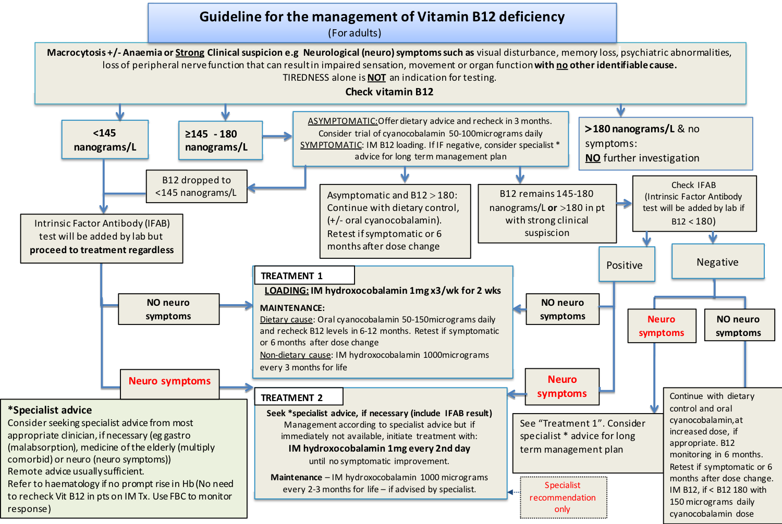

Slide 5
Macrocytosis +/- Anaemia
or Strong Clinical suspicion e.g. neurological symptoms
TIREDNESS alone is NOT an indication for testing
CHECK B12
LOW
<145 ng/L
BORDERLINE
≥145 - 180 ng/L
NORMAL
>180 ng/L
If
symptoms

Slide 6
LOW
<145 ng/L
BORDERLINE
≥145 - 180 ng/L
NORMAL
>180 ng/L
Lab will check IFAB
NO neurological symptoms
NEUROLOGICAL symptoms
Loading
IM hydroxocobalamin 1mg x3/wk for 2 wks
Maintenance
Dietary cause - Oral cyanocobalamin 50-150𝝁g/day Recheck in 6-12 months.
Non-dietary cause - IM hydroxocobalamin 1mg every 3 months for life
Loading
IM hydroxocobalamin 1mg every 2nd day until no symptomatic improvement.
Maintenance
IM hydroxocobalamin 1mg every 2-3 months for life – if advised by specialist.
Seek specialist advice, if necessary
Notes:
** discuss the specialist advice box

Slide 7
LOW
<145 ng/L
BORDERLINE
≥145 - 180 ng/L
NORMAL
>180 ng/L
Asymptomatic
Offer dietary advice & recheck in 3 months.
Consider trial of cyanocobalamin 50-100𝝁g daily
Symptomatic
IM B12 loading
If IF negative, consider specialist advice for long term management plan
Asymptomatic and B12 > 180ng/L
Continue with dietary control, (+/- oral cyanocobalamin).
B12 dropped to <145 ng/L

Slide 8
145-180 ng/L
or >180 ng/L with strong clinical suspicion
Check IFAB
Positive
TREAT AS LOW
NO neurological symptoms
NEUROLOGICAL symptoms

Slide 9
145-180 ng/L
or >180 ng/L with strong clinical suspicion
Check IFAB
Positive
Negative
NO neurological symptoms
NEUROLOGICAL symptoms
TREAT AS LOW
Continue with dietary control & oral cyanocobalamin - increased dose if appropriate.
B12 monitoring in 6 months. Retest if symptomatic or 6 months after dose change.
Load with IM B12
Seek advice for long term plan
NO neurological symptoms
NEUROLOGICAL symptoms

Slide 10
Medications/ Conditions that typically cause low B12
Antibiotics
Anticonvulsants
Colchicine
GI surgery
Metformin
OCP/ HRT
Pregnancy
PPIs/H2 antagonists
Vegan/Vegetarian diets
Notes:
There is a page in the guidance listing medications and conditions that frequently causes B21 deficiency with some advice about each one. For example, it’s not recommended that you test in preganancy and on the OCT/ HRT unless patient is symptomatic. It’s known that in the 3rd trimester of pregnancy that total B12 leels drop due to a reduction in the carrier protein, but that it doesn’t necessarily reflect active cobalamin levels.
If symptomatic and levels are low, then can treat according to non-pregnant patient.

