Slide 1
A quick guide to Immunology testing in Pernicious Anaemia
Dr Charu
Consultant Immunologist
NHS Lothian

Slide 2
The best ‘test’ to diagnose Pernicious Anaemia (PA) is probably largely related to your clinical judgement (!)
Excluding causes other than PA:
Diet / medications / other risk factors for B12 deficiency
Other causes of malabsorption – GI disease, Gastric surgery, medications
Factors to consider re PA:
Presence of other autoimmune disease, e.g Type 1 Diabetes Mellitus, Hashimoto’s thyroiditis/ autoimmune thyroid disease, vitiligo, Hypoadrenalism (Addison’s Disease). Family history of autoimmune disease?
Prevalence of PA: little current data; more common in Scandinavian, English, and Irish populations. In these populations ~ 9 new cases per 100,000 and prevalence is ~ 0.13 % of population (data from 1969).
The only more recent population survey reported that 1.9% of persons more than 60 years old has undiagnosed PA (1996).
UK incidence of pernicious anaemia population estimated
~ 1–5 / 100 000 per annum [extrapolated from National Health and Nutrition Examination Survey (NHANES) reports in the United States]
Notes:
For Scotland – guestimate at ~ 250 new cases per annum
6500 existing patients with PA?
Some good Scottish population data would be very interesting here and help inform clinical practice.

Slide 3
The Test to do – Intrinsic Factor Antibody
Intrinsic factor antibody test
Serum sample sent to Immunology (RIE): reflexly done on all patients found to have low B12 levels (< 180 ng/L)
ELISA; largely automated assay
Turn Around Time : 14 days
If the test is positive: then this is consistent with a diagnosis of pernicious anaemia. False positives are rarely seen.
If IFAB is negative: please note that 30-50% of patients with pernicious anaemia are intrinsic factor antibody NEGATIVE, so autoimmune aetiology is not excluded.
Diagnosis of patients with IF antibody negative PA relies on clinical assessment (other risk factors)
Notes:
We use The Quantalite IFAB assay
Purified recombinant human Intrinsic Factor bound to wells. Std ELISA. Colormetric change measured.

Slide 4
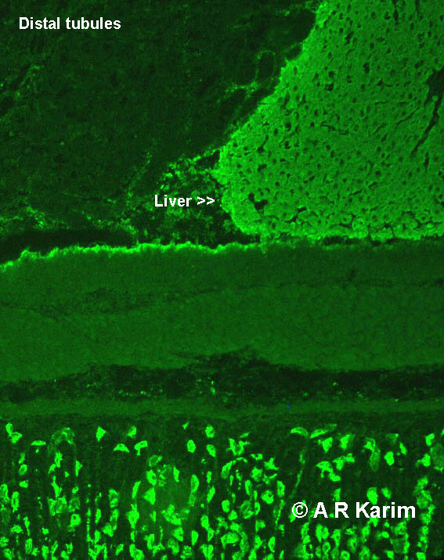
Gastric Parietal Cell Antibody
Detected by Indirect Immunofluorescence technique: Rodent stomach / liver / kidney block slide.
Therefore testing for Smooth Muscle Antibody / LKM1 antibody / Anti-mitochondrial antibody done simultaneously

Slide 5
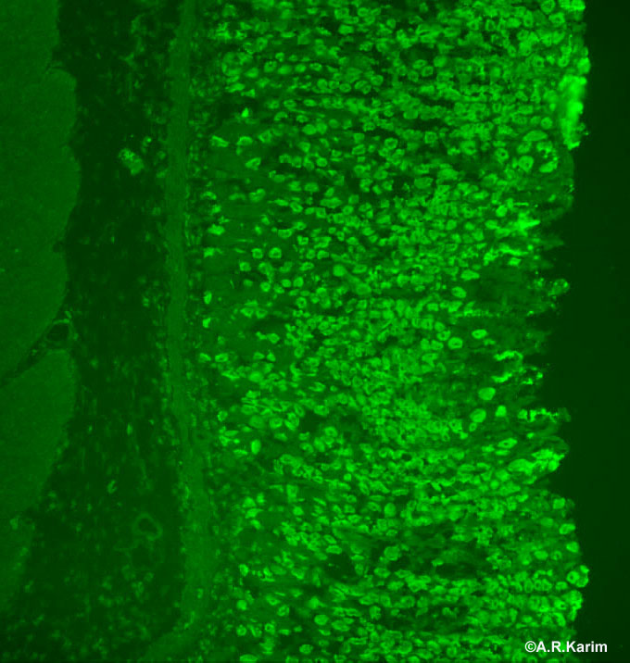
Gastric Parietal Cell Antibody
Antigen: H⁺K⁺-ATPase located in the gastric parietal cells of rodent stomach
Although seen in 80% of patients with pernicious anaemia, also seen in other autoimmune conditions as well as 10% of normal population (Devalia et al., 2014)
https://www.birmingham.ac.uk/facilities/clinical-immunology-services/autoimmunity/other-antibody-patterns/index.aspx

Slide 6
Guidelines for the diagnosis and treatment of cobalamin and folate disorders Devalia et al.,BJH (2014)
New Guidelines for the diagnosis and treatment of cobalamin and folate disorders
All patients with anaemia, neuropathy or glossitis, and suspected of having pernicious anaemia, should be tested for anti-IFAB (Grade 1A).
Patients found to have a low serum cobalamin level in the absence of anaemia and who do not have food malabsorption or other causes of deficiency, should be tested for IFAB to clarify whether they have an early/latent presentation of pernicious anaemia (Grade 2A).
Anti-GPC antibody testing for diagnosing pernicious anaemia is not recommended (Grade 1A).

Slide 7
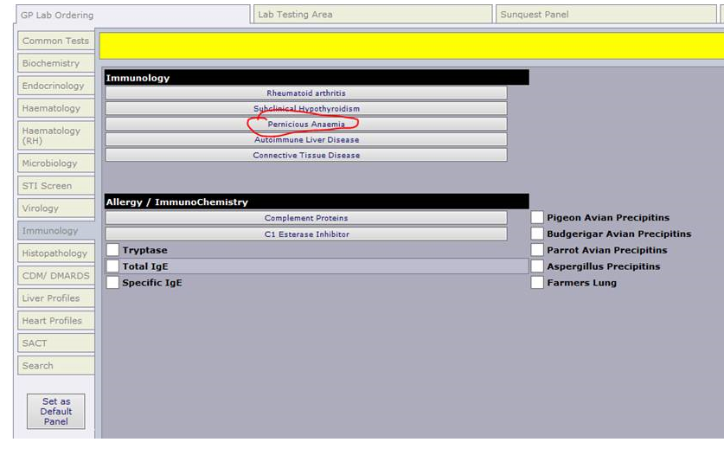
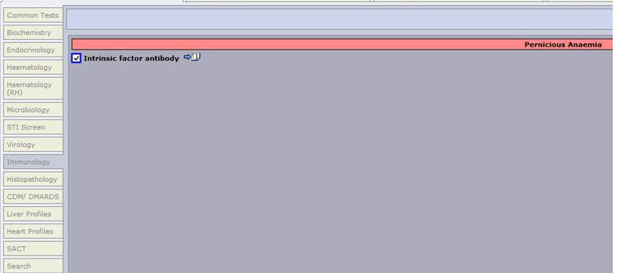
Change to Order Comms

Slide 8
Autoantibody Testing in B12 Deficiency
Questions that we really don’t know the answers to (no formal current published data):
How common is B12 deficiency in Scotland?
What proportion of this is due to Pernicious Anaemia?
How many patients with B12 deficiency require long term i.m B12 replacement?
Does GPC antibody testing help inform clinical management? Should it be entirely removed from lab test repertoire?
If you are interested in studying this – please contact me!!

Slide 9
Thank you
charuchopra@nhs.net

