Slide 1
Goldilocks and the haematologist
Low Ferritin, high ferritin, ferritin just right
By Nicole priddee (consultant haematologist, rie)
Plig GP Update evening, pollock halls, 18/1/18

Slide 2
overview
Iron regulation
Interpretation of iron studies
High ferritin: approach to investigation

Slide 3
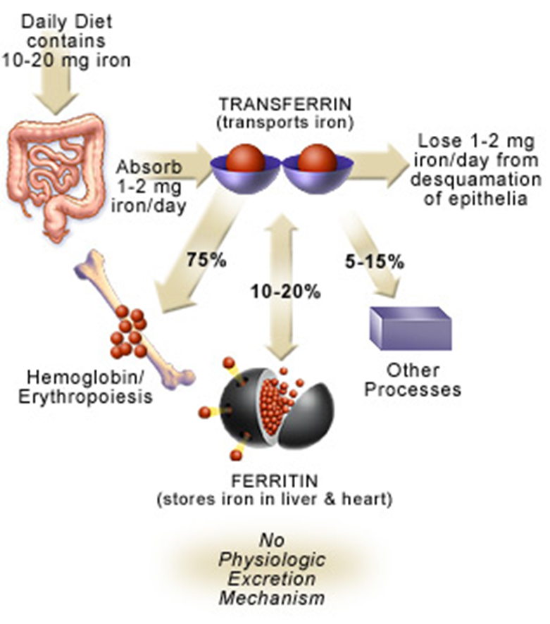
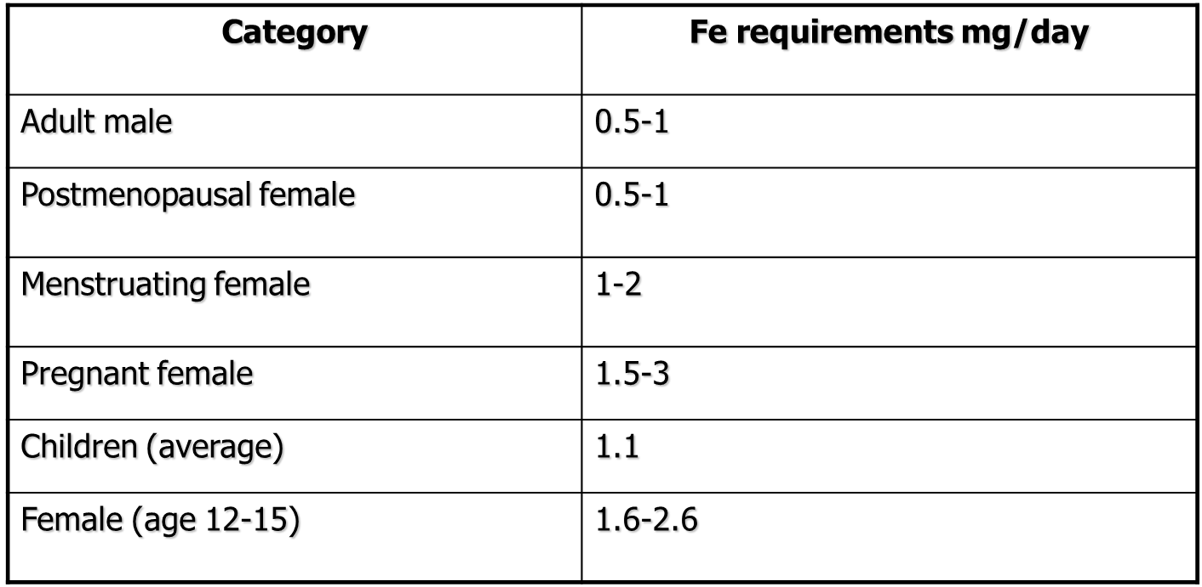
Iron distribution
Iron requirements
Review on iron and its importance for human health. J Res Med Sci 2014;19:164-74

Slide 4
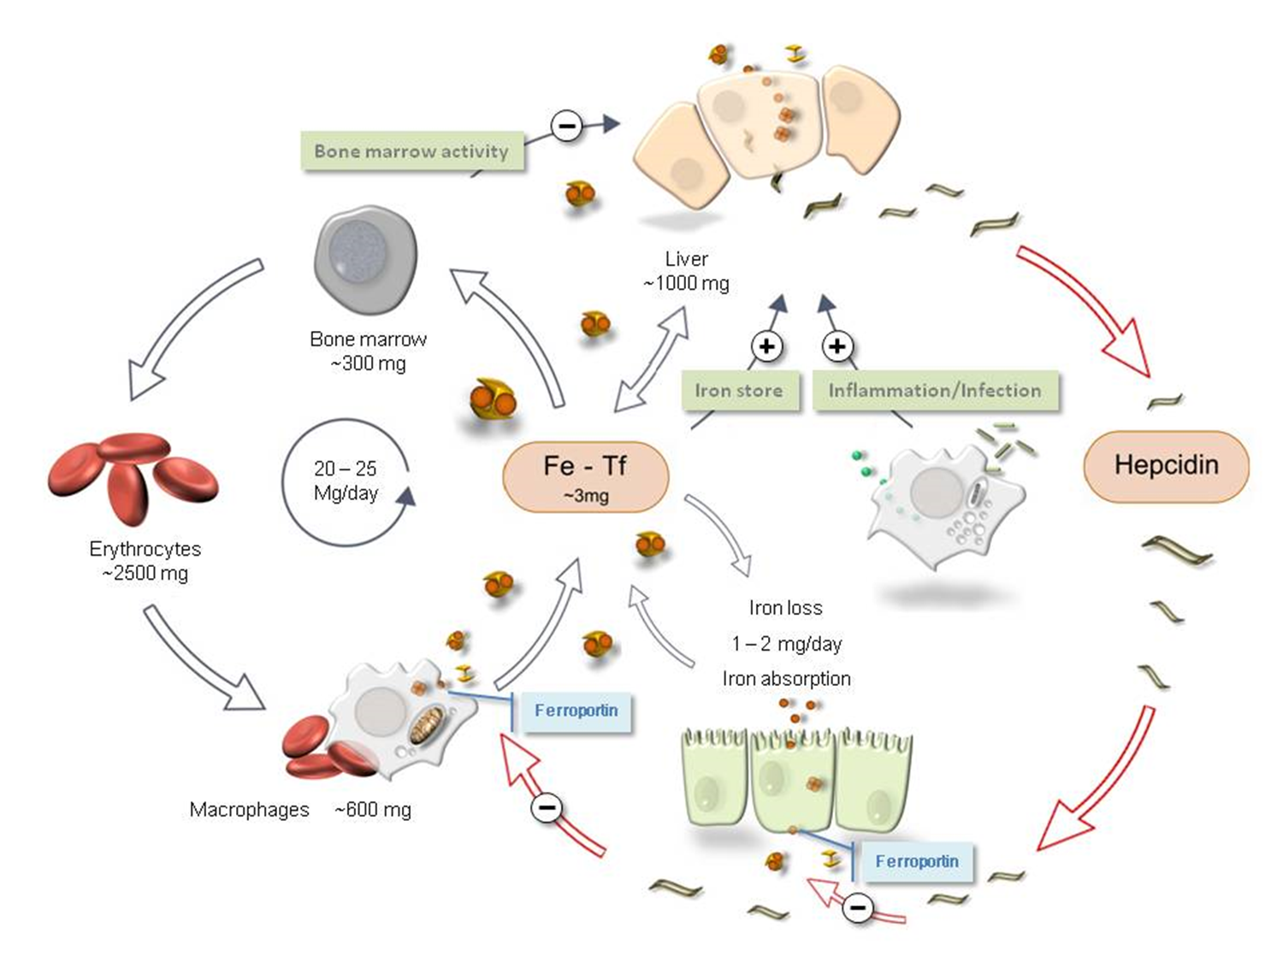
Iron regulation
Clinical Chemistry Dec 2011, 57 (12) 1650-1669

Slide 5
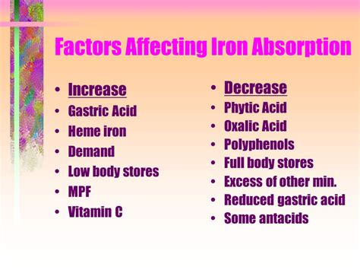
Factors influencing iron absorption
Bioavailability
High gastric pH
Disruption of intestinal structure
Inhibitors
Competitors
Facilitators
http://slideplayer.com/slide/5076841/

Slide 6
Interpretation of iron studies

Slide 7
Anaemia of Chronic Disease (aocd) vs Iron Deficiency Anaemia (ida)
 | MCV (fl) | MCH (pg/ml) | Ferritin (ng/ml) | RCC x 10¹²/L
Iron deficiency | ↓ | ↓ | ↓/↔ | ↓
AoCD | ↓/↔ | ↔ | ↔/↑ | ↓
Adapted from Leach, M (2014) JRCPE; 44:36-41

Slide 8
Iron Studies
Fe (μmol/L) – Circulating iron [nr:10-32]
Transferrin (g/L) – Transporter protein [nr:2-4]
Transferrin saturation (%) - Fe/TIBC
Ferritin (μg/L) – Cellular Storage Protein [nr: 15-200 menstruating females; 15-300 males and post-menopausal females]
Nr= normal range

Slide 9
Iron Studies
Disease | Serum Iron | Transferrin | Transferrin saturation | Ferritin
Iron deficiency | ↓ | ↑ | ↓ | ↓
AoCD | ↓ | ↓ | ↓/↔ | ↑/↔
Iron deficiency & AoCD | ↓ | ↔ (high normal) | ↓ | ↑/↔

Slide 10
Co-existing AoCD and IDA
Difficult to diagnose
Lower than expected ferritin (in context of inflammation) (100 μg/L)
High normal transferrin (>3 G/L)
NB Serum iron is labile and difficult to interpret

Slide 11
differentiating AoCD and IDA
Clinical history
FBC
Iron stores
Renal function
Inflammatory markers
Trial of iron supplementation

Slide 12
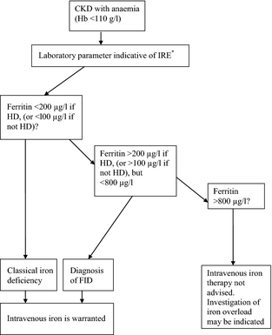
special considerations: Renal Patients
British Journal of Haematology
Volume 161, Issue 5, pages 639-648, 10 APR 2013 DOI: 10.1111/bjh.12311
http://onlinelibrary.wiley.com/doi/10.1111/bjh.12311/full#bjh12311-fig-0001
Notes:
12
Management of iron‐restricted erythropoiesis in patients with CKD on ESA. *Where IRE (iron‐restricted erythropoiesis) is defined by: Percentage of hypochromic red cells (%HRC) > 6%. Reticulocyte haemoglobin content (CHr) < 29 pg. Reticulocyte haemoglobin equivalent (Ret‐He) < 30·6 pg Or indicative values from other red cell or reticulocyte parameter. CKD, chronic kidney disease; ESA, erythropoiesis stimulating agent; FID, functional iron deficiency; HD: haemodialysis.
IF THIS IMAGE HAS BEEN PROVIDED BY OR IS OWNED BY A THIRD PARTY, AS INDICATED IN THE CAPTION LINE, THEN FURTHER PERMISSION MAY BE NEEDED BEFORE ANY FURTHER USE. PLEASE CONTACT WILEY'S PERMISSIONS DEPARTMENT ON PERMISSIONS@WILEY.COM OR USE THE RIGHTSLINK SERVICE BY CLICKING ON THE 'REQUEST PERMISSIONS' LINK ACCOMPANYING THIS ARTICLE. WILEY OR AUTHOR OWNED IMAGES MAY BE USED FOR NON-COMMERCIAL PURPOSES, SUBJECT TO PROPER CITATION OF THE ARTICLE, AUTHOR, AND PUBLISHER.

Slide 13
Aocd/ida – who to refer
Ida
  To haematology: Pre-menopausal females without gi symptoms who are intolerant of or unresponsive to oral iron supplements
  To gastroenterology for endoscopy: 1) post-menopausal females or males > 50 years with no obvious causes of blood loss; 2) patients with aocd whose hb has improved following a trial of oral iron
Aocd
  Optimisation of management of underlying condition(s) is generally sufficient and no secondary care referral is necessary
  To relevant specialty: if optimisation of chronic illness difficult in primary care
  To haematology: 1) if management of underlying condition(s) optimised and patient symptomatic with hb <100 g/l; 2) if other unexplained blood abnormalities present

Slide 14
high ferritin: approach to investigation

Slide 15
High ferritin - history
Clinical history
  Testing indication
  Infection/inflammation/recent surgery
  Medication - ? Oral or iv iron
  ethnicity
  Known haemoglobinopathy/chronic haemolysis
  Liver disease -ald/viral hepatitis/nafld
  Transfusion history

Slide 16
High ferritin - investigation
Iron studies
  Tsat >50%, consider haemochromatosis & do hfe gene testing
  Tsat <50%, consider other diagnoses
Lfts
Ldh, calcium, albumin, urate
Inflammatory markers
US abd, if risk factors for liver disease (alcohol intake, obesity, diabetes)

Slide 17
Understanding hfe gene results
Hfe gene testing will diagnose 95% of patients with hereditary haemochromatosis
hereditary haemochromatosis
  C282y homozygote –highest risk of iron overload
  C282y/h63d compound heterozygote – intermediate risk of iron overload
  H63d homozygote – low risk of iron overload
NOT hereditary haemochromatosis
  C282y heterozygote
  H63d heterozygote

Slide 18
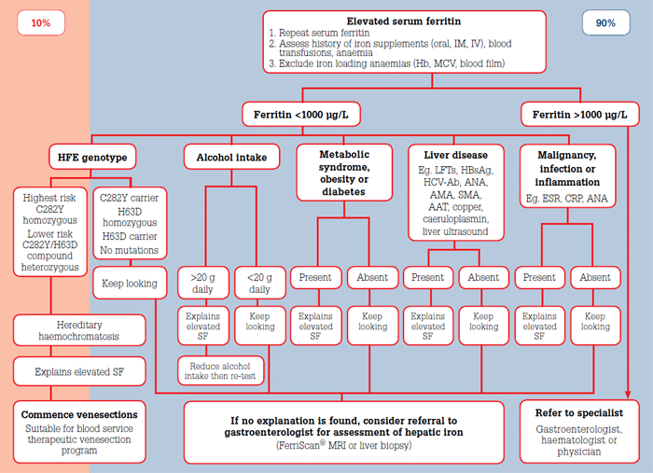
Goot et al (2012) Elevated serum ferritin: What should GPs know? AFP 41(12):945-949.

Slide 19
High ferritin – who to refer
To haematology:
  Confirmed haemochromatosis (c282y homozygotes and c282y/h63d compound heterozygotes) with normal lfts
  Patients with elevated ferritin and t sat > 50% and normal lfts (Please send hfe genotyping at point of referral)
  Unexplained Ferritin > 1000 μg/l and normal lfts
To gastroenterology/hepatology
  Confirmed haemochromatosis (c282y homozygotes and c282y/h63d compound heterozygotes) with abnormal lfts
  Patients with elevated ferritin and t sat > 50% and abnormal lfts (Please send hfe genotyping at point of referral)
  Unexplained Ferritin > 1000 μg/l and abnormal lfts

Slide 20
References
ADAMS & BARTON (2005) A diagnostic approach to hyperferritinemia with a non-elevated transferrin saturation j hepatol 55(2):453-8.
Cullis (2013) anaemia of chronic disease clinical medicine 13(2):193-6.
Goddard et al (2011) Guidelines for the management of iron deficiency anaemia gut 60:1309-1316.
Goot et al (2012) Elevated serum ferritin: what should gps know? Afp 41(12):945-949.
leach (2014) Interpretation of the full blood count in systemic disease – a guide for the physician jrcpe 44:36-41.
Melbourne haematology (2013) a guide to interpretation of iron studies http://www.melbournehaematology.com.au/pdfs/guidelines/melbourne-haematology-guidelines-iron-studies.pdf [accessed 17/1/18].

Slide 21
Questions?

