Slide 1
Lothian Heart Failure Diagnostic Pathway
Clare MacRae
Sara Jenks
Alan Japp
Martin Denvir

Slide 2
New Heart Failure Diagnostic Pathway
Pilot for 6 to 12 months
Expected to start March 2017
Confirmation will be sent out to all practices nearer the time
If successful funding should be made available to continue to provide the service

Slide 3
Cardiology Referrals Audit
With permission from Julia Harrington Cardiology Clinical Development Fellow SJH
25 day period April 2016
24 referrals ? heart failure (excluded if arrythmia/valv/IHD)
Of these 2 patients died prior to cardiology review
1 patient died of acute heart failure 16 days after referral
Time to dx/rule out HF 78 days
Current situation poor, much scope for improvement
In response, launch Diagnostic Heart Failure Pathway. Aim to reduce waiting times and improve triage/patient care
Notes:
Discuss new pathway, reasons for this (current long wait time, new SIGN, 2010 NICE guidelines, other parts of UK have access to testing), partnership GPs/cardiologists, provision of NEW clinic specifically for heart failure diagnosis

Slide 4
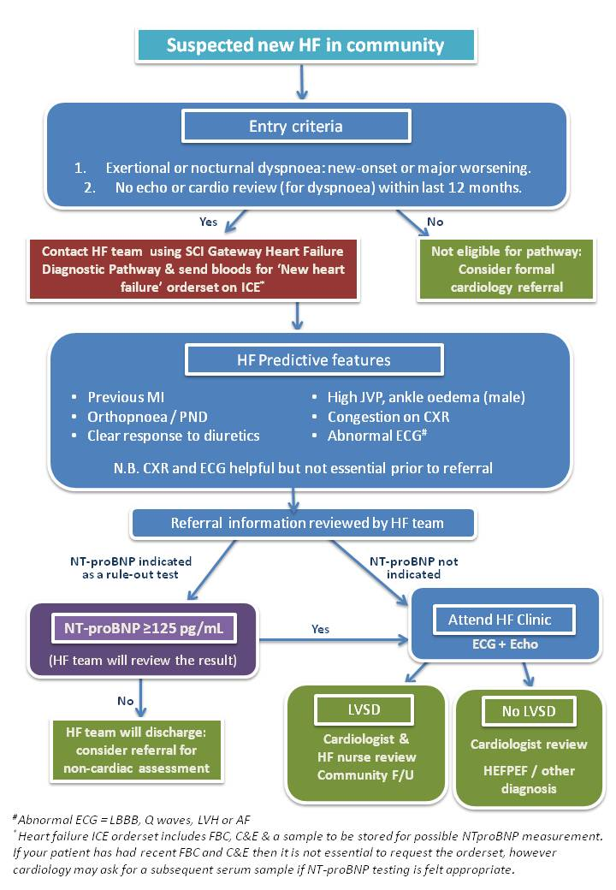

Slide 5
Suspected new HF in community
Entry criteria
Exertional or nocturnal dyspnoea: new-onset or major worsening.
No echo or cardio review (for dyspnoea) within last 12 months.
Yes
No
Contact HF team using SCI Gateway Heart Failure Diagnostic Pathway & send bloods for ‘New heart failure’ orderset on ICE*
Not eligible for pathway:
Consider formal cardiology referral
*Heart failure ICE orderset includes FBC,C&E & sample to be stored for possible NTproBNP. If your patient has had recent FBC and C&E then this is not essential Cardiology may ask for a further sample if NT-proBNP testing appropriate.

Slide 6
HF Predictive features
Previous MI
Orthopnoea / PND
Congestion on CXR
High JVP, ankle oedema (male)
Clear response to diuretics
Abnormal ECG#
N.B. CXR and ECG helpful but not essential prior to referral
#Abnormal ECG = LBBB, Q waves, LVH or AF

Slide 7
Referral information reviewed by HF team
NT-proBNP indicated as a rule-out test
NT-proBNP not indicated
(HF team will review the result)
Yes
ECG + Echo
NT-proBNP ≥125 pg/mL
Attend HF Clinic
No
Cardiologist &
HF nurse review Community F/U
Cardiologist review
HEFPEF / other diagnosis
LVSD
No LVSD
HF team will discharge: consider referral for non-cardiac assessment

Slide 8
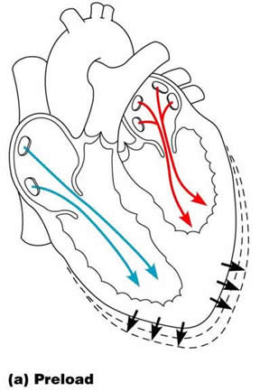
NTproBNP
Released by cardiac muscle in response to stretch
Sensitive for detecting heart failure
Also ↑ in hypertension, MI, AF, VHD, severe COPD, pneumonia, PE, renal impairment, sepsis, cirrhosis,
Recommended for use in diagnostic pathways as a rule out test
<125 pg/ml -rule-out threshold in Lothian
Potential for future roles in monitoring response to treatment

Slide 9
Impact of Age & Gender
Women have higher values than men
Levels in ‘healthy’ individuals increase with age
Age | Median | Upper limit (95th percentile)
18-44 | 36 | 115
45-54 | 49 | 172
55-64 | 73 | 263
65-74 | 107 | 349
>75 | 211 | 738
Total | 50 | 196
Notes:
N=1981 blood donors aged 18-65 and n=283 patients aged 50-90 – no cardiac risks, symptoms or medical history

Slide 10
Impact of Age & Gender
Women have higher values than men
Levels in ‘healthy’ individuals increase with age
Age | Median | Upper limit (95th percentile)
18-44 | 36 | 115
45-54 | 49 | 172
55-64 | 73 | 263
65-74 | 107 | 349
>75 | 211 | 738
Total | 50 | 196
Notes:
N=1981 blood donors aged 18-65 and n=283 patients aged 50-90 – no cardiac risks, symptoms or medical history

Slide 11
NTproBNP in lothian
2 prior attempts to secure funding to make this test freely available for primary care
£110,000 p.a. funding required
Estimated £4,000 p.a. required for NTproBNP use in heart failure diagnostic pathway
Should also be cost savings generated from reduced echo/cardiology attendances
Notes:
2013, (unsuccessful due to large amount of money, lack of support from some within senior lothian management, mixed evidence of success in England)
Ayrshire & Arran and lanarkshire – test as part of new out=patient pathway
D&G in use for 12 years, availabel to primary care and GP then manages test deciding whether cardio referral or echo is appropriate
. Recent D&G audit showed pathway not cost-saving, reworking pathway with increased threshold of NTproBNP to 400 pg/ml and adding in ECG aiming to save 29k through reduced echos. 41% with very elevated BNP >400 were never referred for an echo
Lanarkshire – GP referral, cme to clinic and then POCT NTproBNP test, if negative sent home, if positive have echo and see cardiologist on same day
Ayrshire and Arran – GP referral ?HF, vetted and appointed to HF clinic for POCT NTproBNP & ECG, reviewed and echo arranged if appropriate + cardiology review, If echo not required patients leave knowing diagnosis is unlikely to be cardiac and a lette sent to GPs

Slide 12
NTproBNP across Scotland
Dumfries & Galloway - NTproBNP testing freely available, limited benefit, recent increase in NTproBNP threshold to >400pg/ml
Lanarkshire, Ayrshire & Arran - POCT at cardiology clinic following GP referral
Notes:
2013, (unsuccessful due to large amount of money, lack of support from some within senior lothian management, mixed evidence of success in England)
Ayrshire & Arran and lanarkshire – test as part of new out=patient pathway
D&G in use for 12 years, availabel to primary care and GP then manages test deciding whether cardio referral or echo is appropriate
. Recent D&G audit showed pathway not cost-saving, reworking pathway with increased threshold of NTproBNP to 400 pg/ml and adding in ECG aiming to save 29k through reduced echos. 41% with very elevated BNP >400 were never referred for an echo
Lanarkshire – GP referral, cme to clinic and then POCT NTproBNP test, if negative sent home, if positive have echo and see cardiologist on same day
Ayrshire and Arran – GP referral ?HF, vetted and appointed to HF clinic for POCT NTproBNP & ECG, reviewed and echo arranged if appropriate + cardiology review, If echo not required patients leave knowing diagnosis is unlikely to be cardiac and a lette sent to GPs

Slide 13
Conclusions
New diagnostic heart failure pathway should benefit patients
This is a pilot running for 6-12 months and will be under constant review
NTproBNP referral threshold may change
We would like feedback from both patients and GPs about the pathway
Notes:
– it’s a new clincial service, new clinic, expedited appointments, avoidance of unecessary hopsital attendances for those with low NTproBNP results

