Slide 1
New diabetes diagnosis pathway PLIG, 19th Jan 2017
Jonathan Malo (StR, Clinical Biochemistry)
Nicola Zammit
(Consultant – Diabetes & Endocrinology,
Chair of Diabetes MCN)

Slide 2
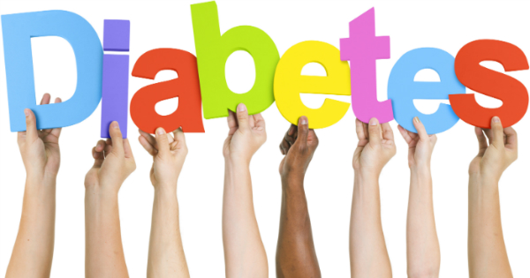
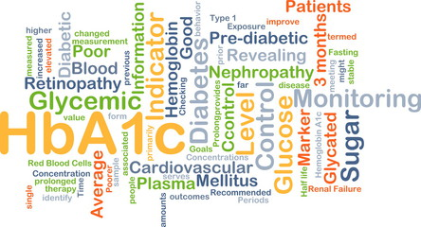
New local pathway:
Diagnosis of Diabetes in Asymptomatic adults
Piloted in 2015 in SE Edinburgh GP practices
Lothian-wide implementation from Oct 2016…
Incorporates HbA1c in recognition of:
expert consensus on use of HbA1c for diagnosis
principal means for guiding diabetes management
relative ease / convenience compared to fasting glucose, or OGTT
However… glucose remains 1st line test:
HbA1c £4.00 Glucose £0.70
number of primary care requests imply an unacceptable increase in cost & workload from switching to HbA1c as 1st line test
HbA1c 67,994
Glucose 194,518
2016 primary care:

Slide 3
Diagnosis of diabetes mellitus in ASYMPTOMATIC adults
(If elderly, frail and asymptomatic, please consider whether screening is appropriate.)
random
glucose
≥11.1 mmol/L
fasting
glucose
≥7.0 mmol/L
INITIAL
lab
glucose
(random
OR
fasting)
random
glucose
7.8 – 11.0 mmol/L
fasting
glucose
6.1 – 6.9 mmol/L

Slide 4
Diagnosis of diabetes mellitus in ASYMPTOMATIC adults
(If elderly, frail and asymptomatic, please consider whether screening is appropriate.)
Take together on
separate day
Determine whether at risk / diabetic
(see fasting glucose & HbA1C ranges below)
random
glucose
≥11.1 mmol/L
fasting
glucose
& HbA_{1C}
fasting
glucose
≥7.0 mmol/L
INITIAL
lab
glucose
(Omit HbA1C if not suitable. See below.*)
(random
OR
fasting)
random
glucose
7.8 – 11.0 mmol/L
fasting
glucose
6.1 – 6.9 mmol/L

Slide 5
Diagnosis of diabetes mellitus in ASYMPTOMATIC adults
(If elderly, frail and asymptomatic, please consider whether screening is appropriate.)
Take together on
separate day
Determine whether at risk / diabetic
(see fasting glucose & HbA1C ranges below)
random
glucose
≥11.1 mmol/L
fasting
glucose
& HbA_{1C}
fasting
glucose
≥7.0 mmol/L
INITIAL
lab
glucose
(Omit HbA1C if not suitable. See below.*)
(random
OR
fasting)
random
glucose
7.8 – 11.0 mmol/L
fasting
glucose
6.1 – 6.9 mmol/L
* Not suitable for HbA_{1C}
1) Rapid onset of diabetes
a. Suspected T1DM – see symptomatic patient flowchart
b. Drug-induced: steroids, anti-psychotics, immuno-suppressants – a fasting glucose may not be sufficient.
c.Pancreatic disease
2) Conditions affecting Hb turnover / HbA1C assay
a. Haemoglobinopathy
b. Anaemia (especially haemolytic)
c. Severe blood loss, Blood transfusion
d. Splenomegaly / Splenectomy
e. Renal dialysis +/- erythropoitein
f. Anti-retrovirals, ribavarin, dapsone
3) Children
Seek diabetes team advice
* Pregnancy - see local guidelines for screening/referral
a. HbA1C may be used to screen for pre-existing diabetes,
but should NOT be used to screen for Gestational Diabetes (GDM)
b. Note that the OGTT for GDM uses lower cut-offs:
Fasting glucose ≥5.1 mmol/L, 2-hr glucose ≥8.5 mmol/L

Slide 6
Diagnosis of diabetes mellitus in ASYMPTOMATIC adults
(If elderly, frail and asymptomatic, please consider whether screening is appropriate.)
Take together on
separate day
Determine whether at risk / diabetic
(see fasting glucose & HbA1C ranges below)
random
glucose
≥11.1 mmol/L
fasting
glucose
& HbA_{1C}
fasting
glucose
≥7.0 mmol/L
INITIAL
lab
glucose
(Omit HbA1C if not suitable. See below.*)
(random
OR
fasting)
random
glucose
7.8 – 11.0 mmol/L
fasting
glucose
6.1 – 6.9 mmol/L
suitable for HbA_{1C}? *
YES
NO
(repeat blood test on a separate day)
HbA_{1C}
OGTT
(75 g)

Slide 7
Diagnosis of diabetes mellitus in ASYMPTOMATIC adults
(If elderly, frail and asymptomatic, please consider whether screening is appropriate.)
Take together on
separate day
Determine whether at risk / diabetic
(see fasting glucose & HbA1C ranges below)
random
glucose
≥11.1 mmol/L
fasting
glucose
& HbA_{1C}
fasting
glucose
≥7.0 mmol/L
INITIAL
lab
glucose
(Omit HbA1C if not suitable. See below.*)
(random
OR
fasting)
random
glucose
7.8 – 11.0 mmol/L
fasting
glucose
6.1 – 6.9 mmol/L
suitable for HbA_{1C}? *
YES
NO
(repeat blood test on a separate day)
HbA_{1C}
OGTT
(75 g)
not diabetic
not diabetic
≤41
mmol/mol
fasting
glucose
≤6.0
mmol/L
AND
2-hr
glucose
≤7.7
mmol/L

Slide 8
Diagnosis of diabetes mellitus in ASYMPTOMATIC adults
(If elderly, frail and asymptomatic, please consider whether screening is appropriate.)
Take together on
separate day
Determine whether at risk / diabetic
(see fasting glucose & HbA1C ranges below)
random
glucose
≥11.1 mmol/L
fasting
glucose
& HbA_{1C}
fasting
glucose
≥7.0 mmol/L
INITIAL
lab
glucose
(Omit HbA1C if not suitable. See below.*)
(random
OR
fasting)
random
glucose
7.8 – 11.0 mmol/L
fasting
glucose
6.1 – 6.9 mmol/L
suitable for HbA_{1C}? *
YES
NO
(repeat blood test on a separate day)
HbA_{1C}
OGTT
(75 g)
not diabetic
at risk
of DM
not diabetic
at risk
of DM
≤41
mmol/mol
42 – 47
mmol/mol
fasting
glucose
≤6.0
6.1 – 6.9 (IFG)
mmol/L
AND
OR
2-hr
glucose
≤7.7
7.8 – 11.0 (IGT)
mmol/L

Slide 9
Diagnosis of diabetes mellitus in ASYMPTOMATIC adults
(If elderly, frail and asymptomatic, please consider whether screening is appropriate.)
Take together on
separate day
Determine whether at risk / diabetic
(see fasting glucose & HbA1C ranges below)
random
glucose
≥11.1 mmol/L
fasting
glucose
& HbA_{1C}
fasting
glucose
≥7.0 mmol/L
INITIAL
lab
glucose
(Omit HbA1C if not suitable. See below.*)
(random
OR
fasting)
random
glucose
7.8 – 11.0 mmol/L
fasting
glucose
6.1 – 6.9 mmol/L
suitable for HbA_{1C}? *
YES
NO
(repeat blood test on a separate day)
HbA_{1C}
OGTT
(75 g)
not diabetic
at risk
of DM
diabetes
not diabetic
at risk
of DM
diabetes
≤41
mmol/mol
42 – 47
mmol/mol
≥48
mmol/mol
fasting
glucose
≤6.0
6.1 – 6.9 (IFG)
≥ 7.0
mmol/L
AND
OR
OR
2-hr
glucose
≤7.7
≥ 11.1
7.8 – 11.0 (IGT)
mmol/L

Slide 10
Diagnosis of diabetes mellitus in ASYMPTOMATIC adults
(If elderly, frail and asymptomatic, please consider whether screening is appropriate.)
Take together on
separate day
Determine whether at risk / diabetic
(see fasting glucose & HbA1C ranges below)
random
glucose
≥11.1 mmol/L
fasting
glucose
& HbA_{1C}
fasting
glucose
≥7.0 mmol/L
INITIAL
lab
glucose
(Omit HbA1C if not suitable. See below.*)
(random
OR
fasting)
random
glucose
7.8 – 11.0 mmol/L
fasting
glucose
6.1 – 6.9 mmol/L
suitable for HbA_{1C}? *
At risk of DM groups include:
YES
NO
IFG = impaired fasting glucose
IGT = impaired glucose tolerance
HbA_{1C} 42-47 mmol/mol
(repeat blood test on a separate day)
HbA_{1C}
OGTT
(75 g)
Consider lifestyle advice & annual HbA_{1C} check for these groups
not diabetic
at risk
of DM
diabetes
not diabetic
at risk
of DM
diabetes
≤41
mmol/mol
42 – 47
mmol/mol
≥48
mmol/mol
fasting
glucose
≤6.0
6.1 – 6.9 (IFG)
≥ 7.0
mmol/L
AND
OR
OR
2-hr
glucose
≤7.7
≥ 11.1
7.8 – 11.0 (IGT)
mmol/L

Slide 11
Diagnosis of diabetes mellitus in ASYMPTOMATIC adults
(If elderly, frail and asymptomatic, please consider whether screening is appropriate.)
Take together on
separate day
Determine whether at risk / diabetic
(see fasting glucose & HbA1C ranges below)
random
glucose
≥11.1 mmol/L
fasting
glucose
& HbA_{1C}
fasting
glucose
≥7.0 mmol/L
INITIAL
lab
glucose
(Omit HbA1C if not suitable. See below.*)
(random
OR
fasting)
random
glucose
7.8 – 11.0 mmol/L
Where there is diagnostic uncertainty consider contacting diabetes email advice service
fasting
glucose
6.1 – 6.9 mmol/L
suitable for HbA_{1C}? *
At risk of DM groups include:
YES
NO
IFG = impaired fasting glucose
IGT = impaired glucose tolerance
HbA_{1C} 42-47 mmol/mol
(repeat blood test on a separate day)
HbA_{1C}
OGTT
(75 g)
Consider lifestyle advice & annual HbA_{1C} check for these groups
not diabetic
at risk
of DM
diabetes
not diabetic
at risk
of DM
diabetes
≤41
mmol/mol
42 – 47
mmol/mol
≥48
mmol/mol
fasting
glucose
≤6.0
6.1 – 6.9 (IFG)
≥ 7.0
mmol/L
AND
OR
OR
2-hr
glucose
≤7.7
≥ 11.1
7.8 – 11.0 (IGT)
mmol/L

Slide 12
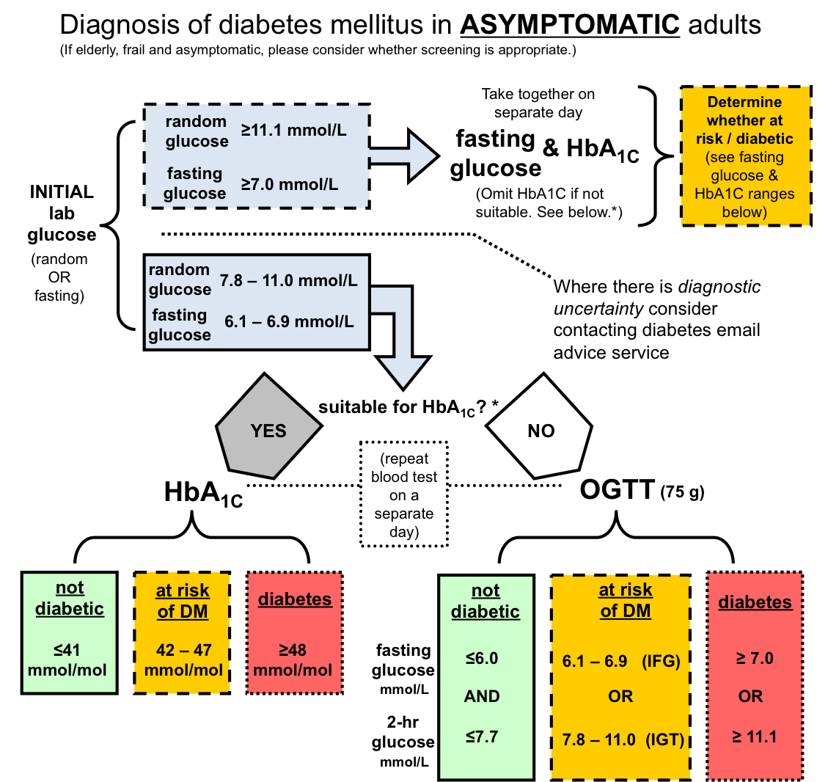
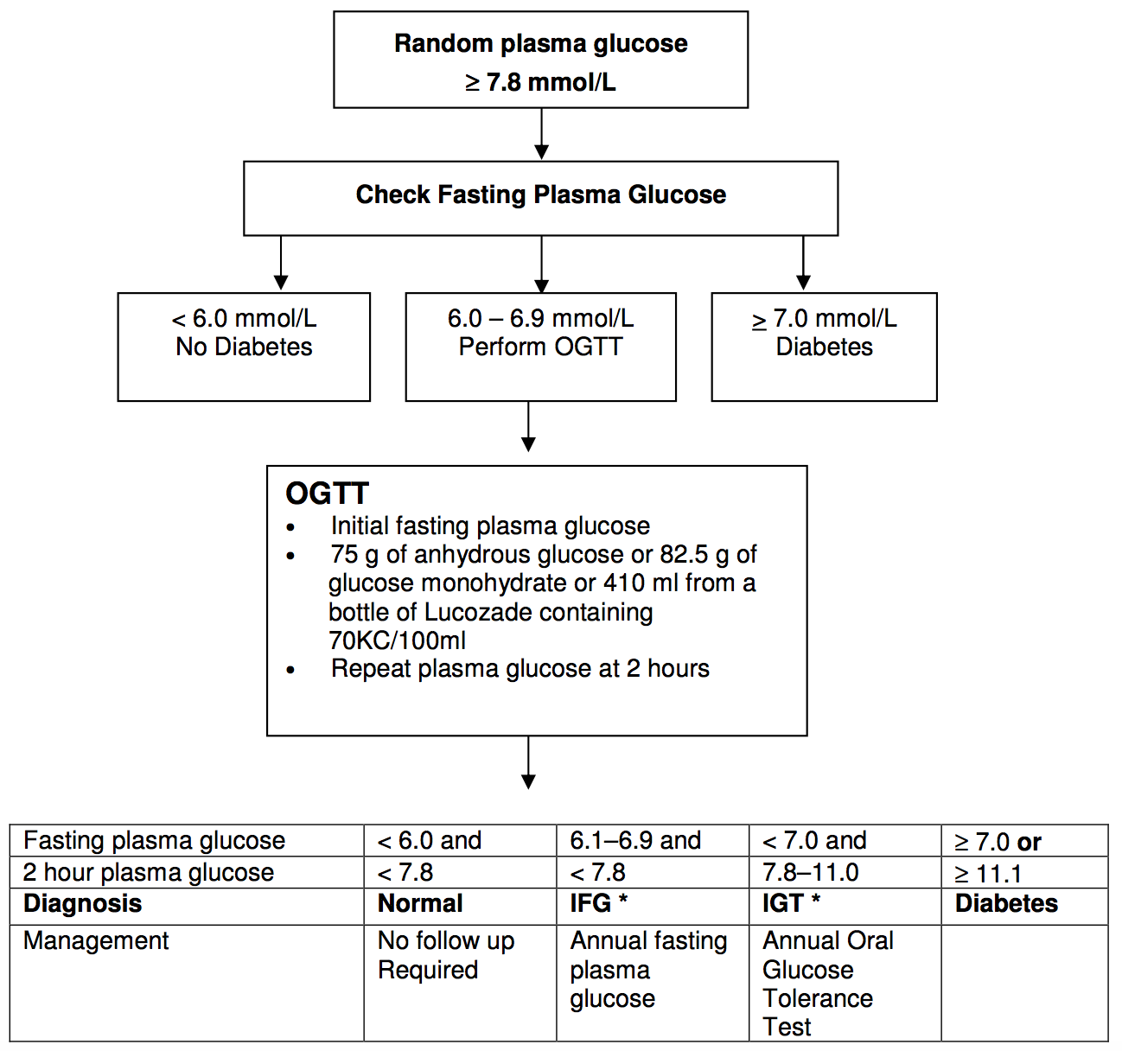
New pathway
Old pathway

Slide 13
New pathway
Old pathway

Slide 14
New pathway
Old pathway
1
2
1
3
2

Slide 15
Trends in HbA1c & glucose testing for Lothian
Yanhong Wang (SCI-Diabetes), Carol Thomson (Labs IT)
Pilot of new pathway in 2015
Compared 6 months pre-pilot vs. 6 months pilot
15 GP practices in SE Edinburgh (~10% of all 1o care testing)
Pilot study results: 2 x 6 month periods
Pan-Lothian testing over same period
 | Pre-pilot | Pilot | % change
HbA1c | 3,481 | 3,429 | -1.5%
Glucose | 10,031 | 9,797 | -2.3%
OGTT | 186 | 151 | -18.8%
 | 6 mth | 2nd 6mth | % change
HbA1c | 30,035 | 31,964 | +6.4%
Glucose | 100,065 | 101,803 | +1.7%
Apparently neutral effect on HbA1c, glucose requesting (reassuring for lab)
OGTT numbers small ?significant fall
Feedback on use of pathway generally positive
Post pilot…
Pathway discussed with clinical leads for diabetes
Distributed Lothian-wide as a recommendation in Oct 2016

Slide 16
Trends in HbA1c & glucose testing for Lothian
Any change since introduction of pathway in Oct 2016?
HbA1c tests (per month) past 2 years
*
*
*
Probably too early to draw any conclusions….
festive dip
Oct ’16:
new pathway starts
Jan’15
Jan’16
Since Oct 2016, possible to distinguish HbA1c requested for diagnosis vs. monitoring:
 | Oct | Nov | Dec
% diagnostic HbA1c | 31% | 32% | 40%
We will continue to follow these ratios over the coming year…

Slide 17
Trends in HbA1c & glucose testing for Lothian
Long view: what is the trend in HbA1c requesting?
HbA1c
HbA1c + glucose
Glucose
HbA1c test numbers are rising… Glucose numbers are static/falling
Possible causes:
- rising diabetic population (hence more HbA1c monitoring)
- increasing use of HbA1c in diagnosis ± monitoring
Both?

Slide 18
Trends in HbA1c & glucose testing for Lothian
NHS Lothian diabetic population
18% increase
over past 5 years
Ratio of HbA1c numbers : diabetic prevalence
No of HbA1c
per diabetic popn
slight increase…

Slide 19
Straw poll – new diabetes diagnostic pathway
How many of you…
are aware of new diagnostic pathway?
have used it?
have had problems with it?
prefer the previous glucose-only pathway?
How many using HbA1c for diagnosis before the new pathway?

Slide 20
Questions?

Slide 21
Other local diagnostic guidelines…
Lothian pathway is very similar to (independently drawn-up) guidelines in:
Glasgow & Greater Clyde
Lanarkshire
Other pathways (some parts of England & Wales):
HbA1c as 1st line test
OR
Risk scoring* as 1st line screening step, then HbA1c for high risk individuals
(Can be conducted opportunistically by HCP or individual, or via electronic health record search.)
*age, sex, ethnicity, fam hx of DM, waist size, BMI, HTN

